Slide 1

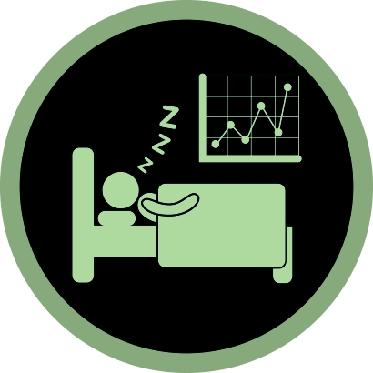

THESIS PROPOSAL
PRESENTED BY
1967-SABIKUN NAHER MONISHA
DEGREE NAME- BSC
SESSION-2018-2019

Slide 2

Content
01
Problem name
02
Our Team
03
Features Name
04
Targeted Device
05
t
06
Future Goals
07
Contact

Slide 3

Background Study
01
The study of sleep is an intriguing field that has drawn a lot of attention recently
The invention of sleep monitoring technology has emerged as
aviable method for tracking and enhancing sleep patterns
02
The information on sleep patterns is gathered and analysed by sleep tracking devices using a mix of sensors and algorithms
03

Slide 4


OUR PROPOSAL
Comparing wearable biosensors performance accuracy of sleep tracking in an ideal environment vs real time environment using machine learning approach .

Slide 5

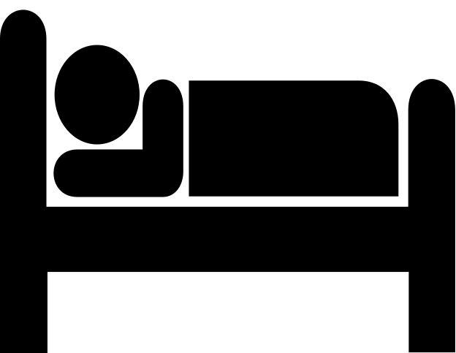


Research Aim
Objective 01
Identify the significance of sleep tracking and sensor efficiency.
Objective 02
Observe the psychological impact of sleep tracking.
Objective 03
Criteria that lead to different outputs in different environments.
Sleep Tracking
Objective 04
Solve the arising issues and suggest a comparatively better model in a real-time environment.

Slide 6

Problems in existing STAs
Among the several problems in STAs, we focused on mainly two points.
Relationality
Medicalization

Slide 7





Relationality
Non-user activity
Prediction Bias
Hindered Data Protection
Non-user activities can interfere with the working of STA.
So, STAs should have a better ability to define the environment.
STA works perfectly in the ideal environment but in regular environments, the results fluctuate.
A person within the arena of the user may be tracked by STAs, without their attention or permission.
So, the Question of data protection occurs.

Slide 8


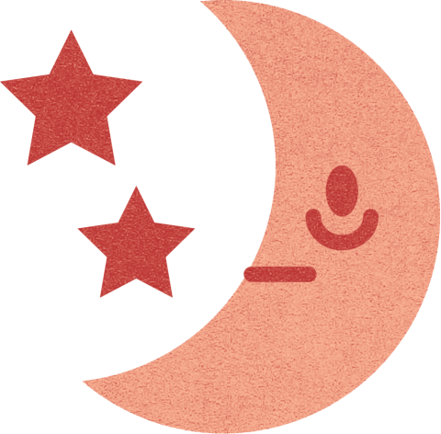

Medicalization
Improper DIstinguishing
Unregulated Use
Psychological Stress
Informational Autonomy
STA needs to distinguish sleep stages properly; which lacks in most of the STAs.
Unregulated use can hamper user health.
Focusing on being perfect as per the STA, user can be more stressed and thus it can lead to worsen insomnia.
Improper distinguishing behavior can make users think that they have proper sleep and refrain from taking proper treatment from doctors.

Slide 9




Sleep Coach Feature
Whoop
Band
PPG
GreenLED
Photodiode
Oura
Ring
Accuracy and Connectivity
Body Temperature Sensors
Optical Infrared Sensors
3d Acclometer
Gyroscope
Targeted Devices and Sensors
Dreem Headband
Accuracy
EEG Sesnor
Pulse Oximeter
Most Available
Smart
Watches
Accelometer
Skin Conductor
Magnetometer
Heart Rate Monitor
Temperature Sensors

Slide 10
ACTIGRAPHY
Use wearable device data for sleep monitoring
Resting heart rate
+
Body Gestures with little or no movement
=
Identify as Sleeping Period.

Slide 11
https://docs.google.com/document/d/14V1BECpF1CqoG13U5nsEGSxy7gyO07pWVMgBzTQIc3w/edit?usp=sharing
References Doc

Slide 12
THANK YOU

